Slide 1


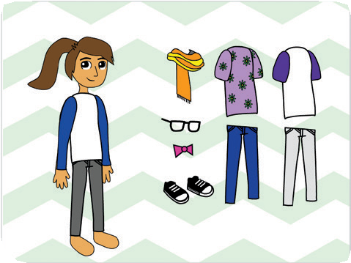
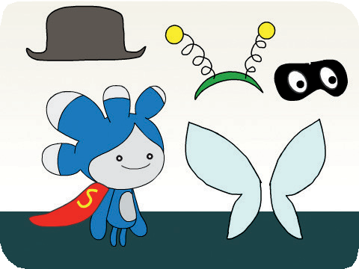
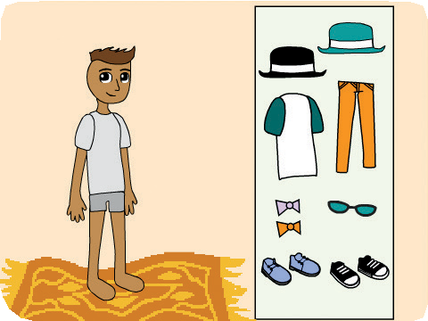
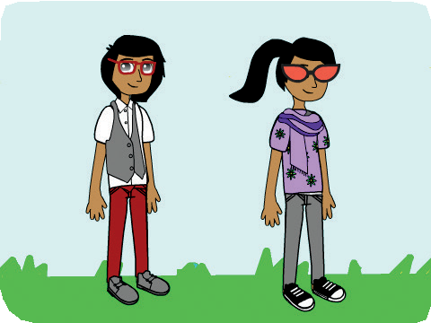

Fashion Game Cards
Fashion Game
Dress up a character with different clothes and styles.
scratch.mit.edu/fashion

Slide 2
Fashion Game Cards
Fashion Game
Start with the first card and then try the other cards in any order:
Choose Your Character
Play with Colors Change Styles Change Backdrops Lay Out Your Clothes Glide into Place Snap into Place
scratch.mit.edu/fashion

Slide 3

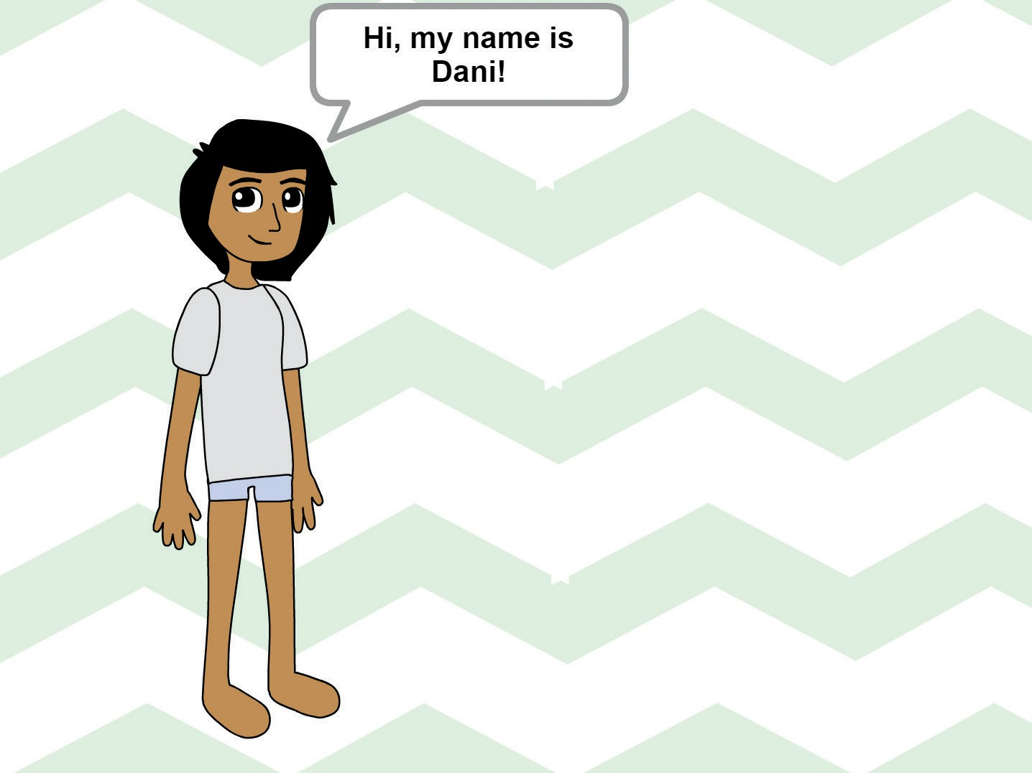
Choose Your Character
Choose your character and have them say something.
Fashion Game
1

Slide 4






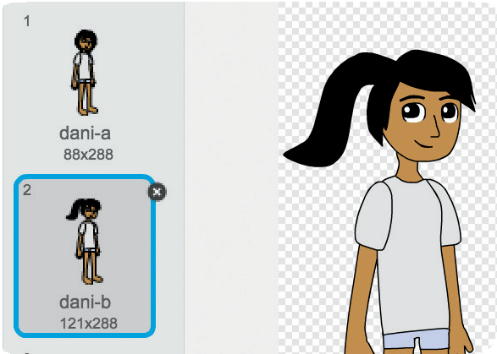
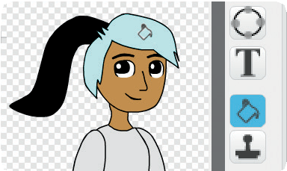

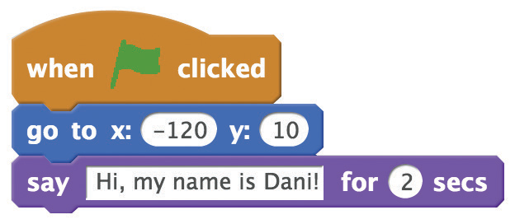

Choose Your Character
scratch.mit.edu/fashion
GET READY
Choose a character from the Dress-Up theme.
Choose a backdrop.
Click the
tab.
Then select the look you want.
You can use the paint bucket to change colors!
ADD THIS CODE
Click the tab.
Set the starting position.
Type what you want your character to say.
TRY IT
Click the green flag to start.

Slide 5
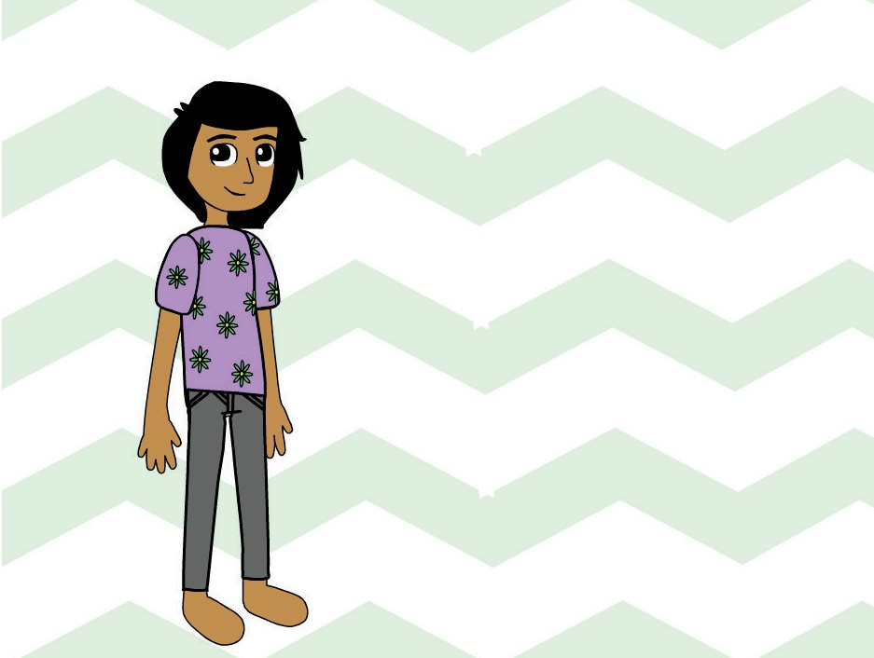
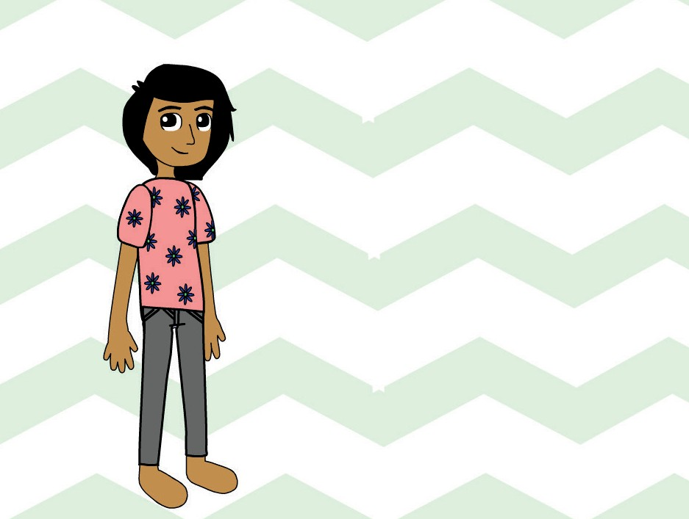
Play with Colors
Click to change the color of clothing.
Fashion Game
2

Slide 6

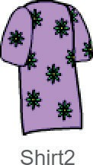
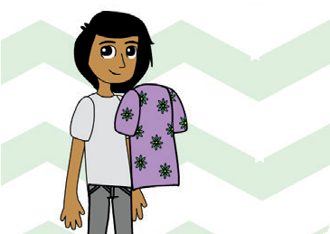

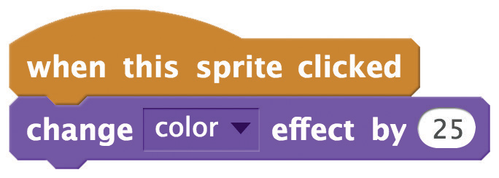

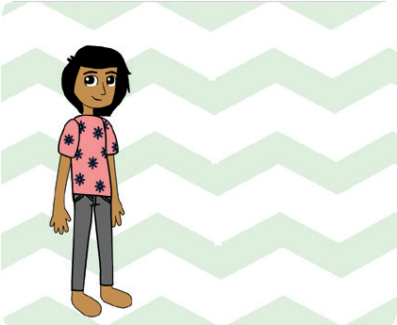
Play with Colors
scratch.mit.edu/fashion
GET READY
Choose a piece of clothing, like Shirt2.
Drag the clothing onto your character.
ADD THIS CODE
TRY IT
Click your clothing to make it change color.

Slide 7
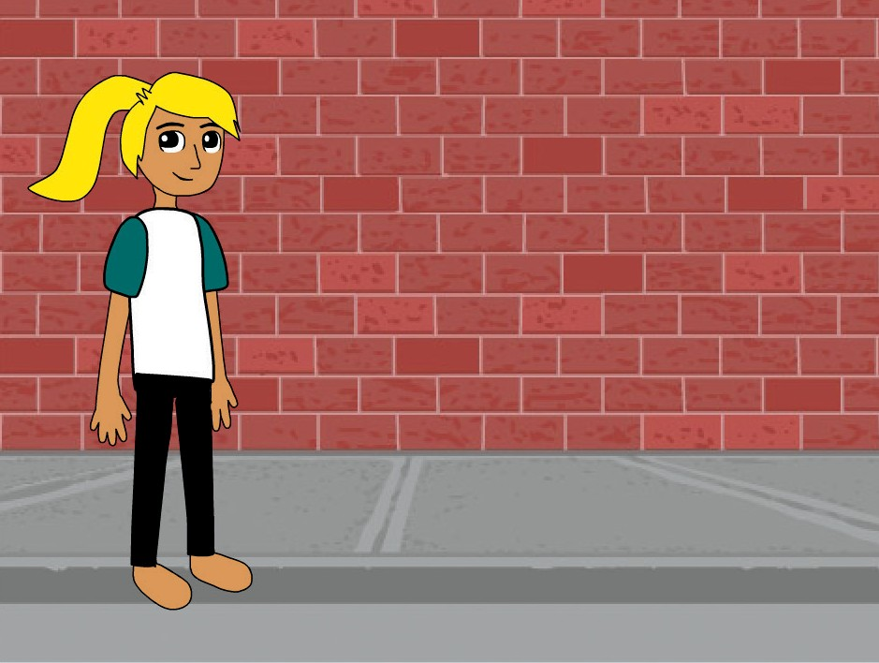
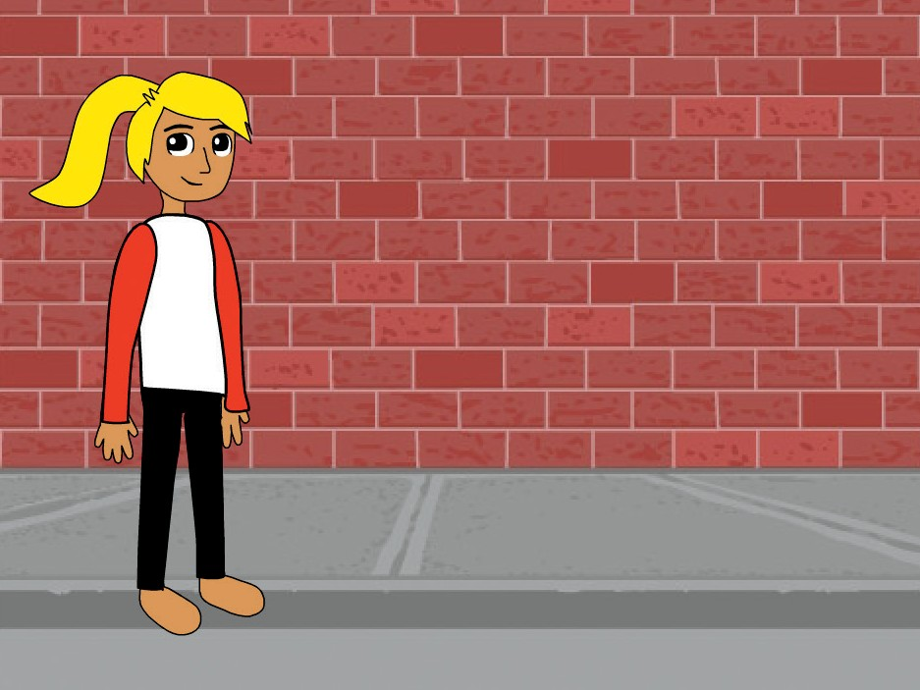
Change Styles
Press a key to switch costumes.
Fashion Game
3

Slide 8

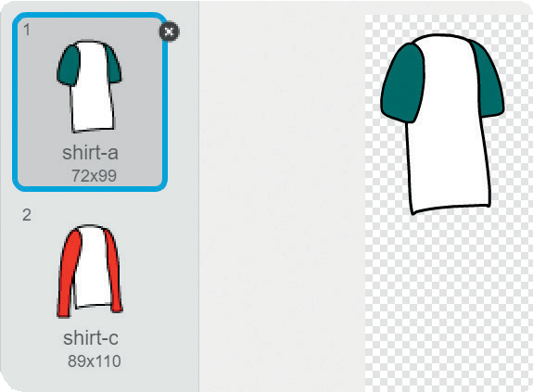

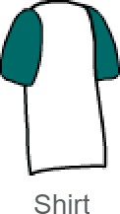
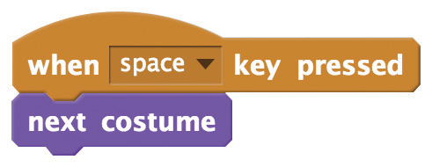
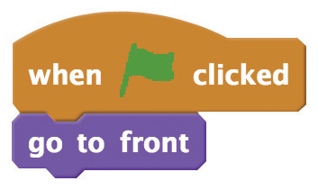

Change Styles
scratch.mit.edu/fashion
GET READY
Choose a piece of clothing, like Shirt.
Click the
tab.
ADD THIS CODE
Click the tab.
Switch between costumes.
Keep the shirt in front of your character.
TRY IT
Click the green
flag to start.
Press the space key to switch between styles.

Slide 9
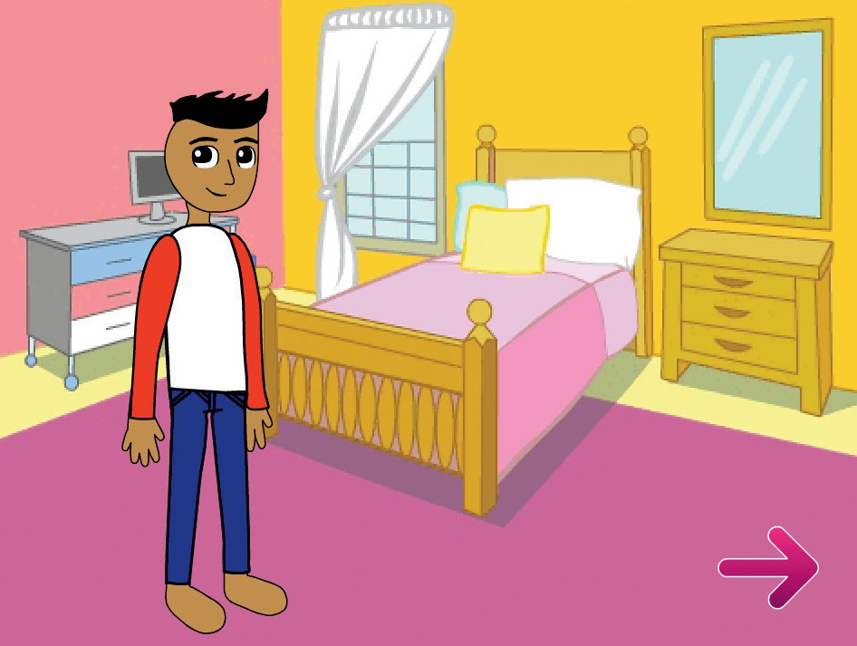
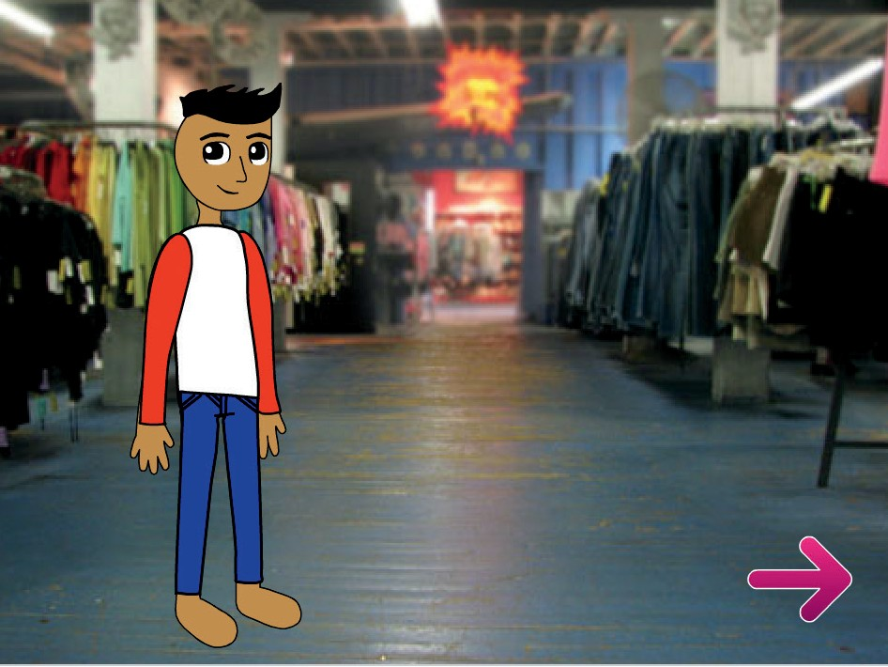
Change Backdrops
Click a button to switch backdrops.
Fashion Game
4

Slide 10
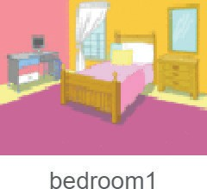


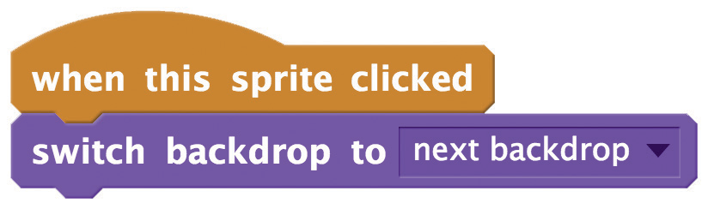

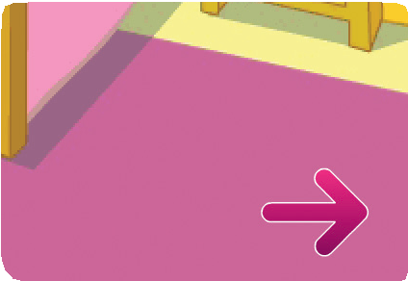
Change Backdrops
scratch.mit.edu/fashion
GET READY
Choose a button sprite, like Arrow1.
Choose two backdrops.
ADD THIS CODE
Choose next backdrop from the menu.
TRY IT
Click your button to switch backdrops.

Slide 11
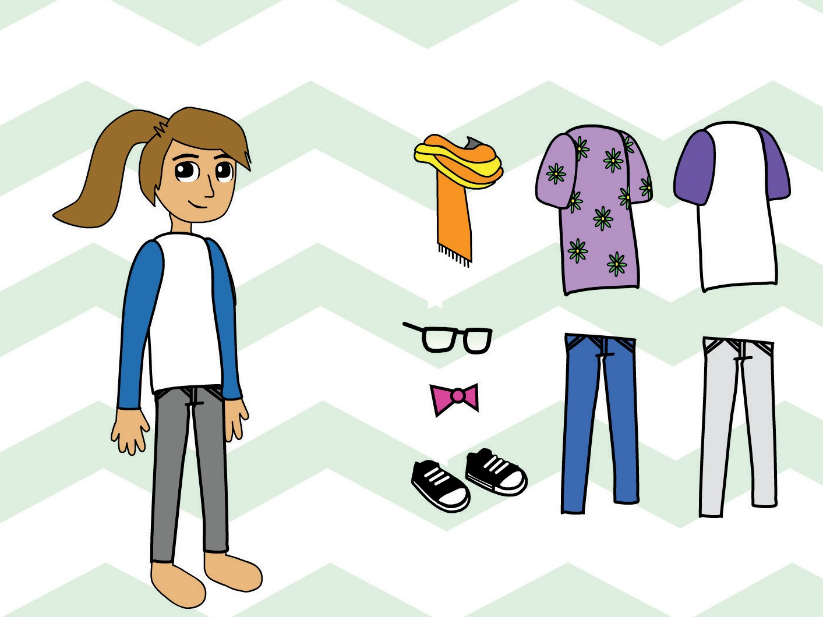
Lay Out Your Clothes
Set out your clothes in their starting positions.
Fashion Game
5

Slide 12

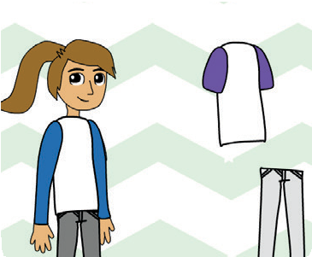

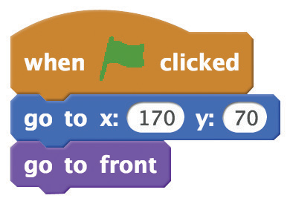
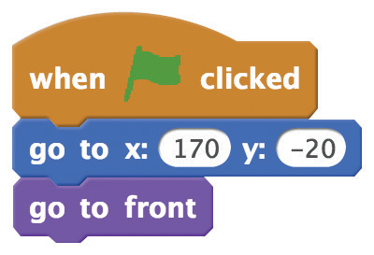



Lay Out Your Clothes
scratch.mit.edu/fashion
GET READY
Choose some clothes and accessories.
Arrange them next to your character.
ADD THIS CODE
Set the starting position for each piece of clothing.
(Your numbers may be different.)
TRY IT
Drag the clothes onto your character.
Click the green
flag to reset.

Slide 13
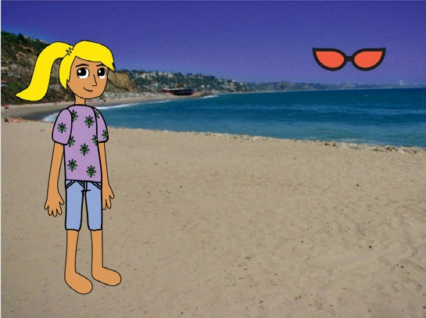
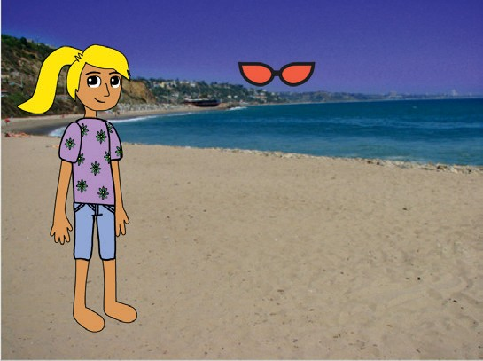
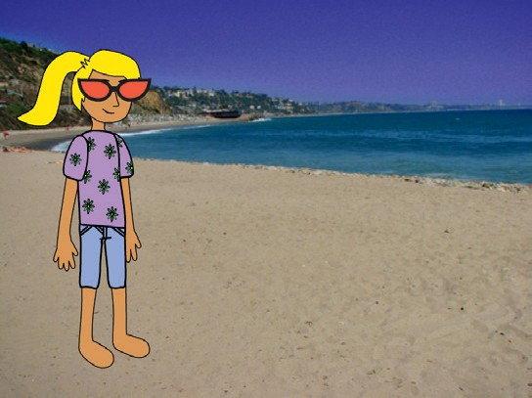
Glide into Place
Make accessories glide to the right place.
Fashion Game
6

Slide 14


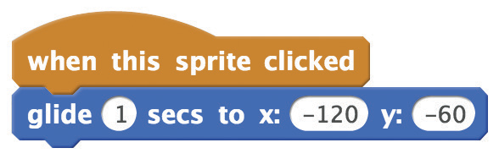

Glide into Place
scratch.mit.edu/fashion
GET READY
Choose a piece of clothing or an accessory, like Sunglasses1.
ADD THIS CODE
Set the starting position.
Drag the sunglasses onto your character and then add the glide block.
Your numbers may be different.
TRY IT
Click the green
flag to reset.
Click the sunglasses to make them glide to your character.

Slide 15
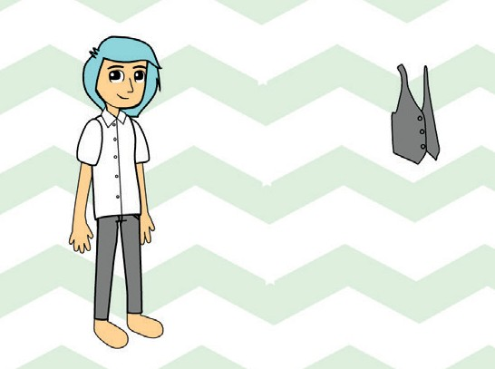
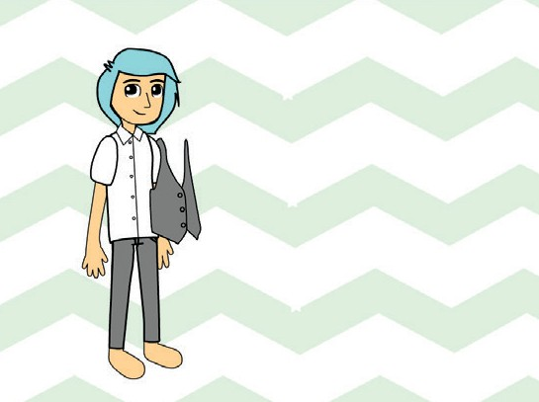
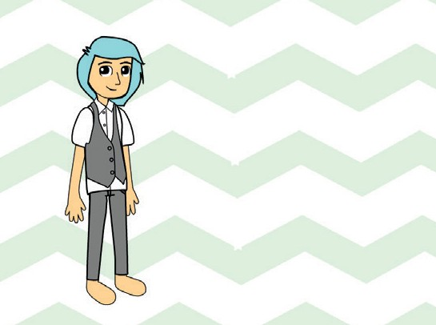
Snap into Place
Make clothes snap into place.
Fashion Game
7

Slide 16



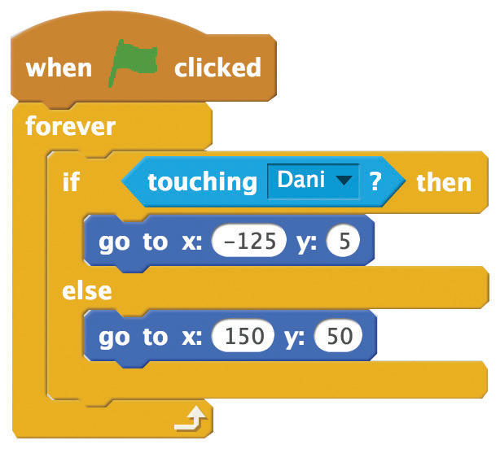

Snap into Place
scratch.mit.edu/fashion
GET READY
Choose a piece of clothing or an accessory, like Vest.
ADD THIS CODE
Drag the clothing onto your character and then add this code.
Choose your character.
Snap onto your character.
Go to starting position.
TRY IT
Click the green
flag to start.
Drag the clothing onto your character. Then it will snap into place!

